Slide 1
Number Plate Detection Vehicles

Slide 2
We are grateful for the opportunity to contribute to the project on Vehicle Number Plate Detection using computer vision. Traditional manual identification of license plates is not only slow and labor-intensive but also highly susceptible to human error. By automating this process, we can achieve greater efficiency, accuracy, and reliability across multiple domains, including law enforcement, parking systems, and toll management.
Our work aims to deliver a robust solution for detecting number plates and accurately extracting the alphanumeric characters, ensuring a faster and more effective approach compared to manual methods.

Slide 3

Model Creation

Slide 4
Steps for Model creation
Clone the YOLOv5 repository from GitHub into the local system.
Create separate directories for labels and training images.
Place the sample label files and image files for number plate detection into their respective folders.
Implement a function to detect and filter out blurred images.
Enhance image quality by applying brightness adjustment and clarity improvement techniques.
Perform image preprocessing and save the processed images back to the same directory.
Configure the training parameters and prepare a YAML configuration file for the YOLOv5 model.
Define the batch size and number of epochs, then train the model using the specified YOLO settings.
Save the trained model locally for future use in number plate detection.

Slide 5
Steps for Streamlit Application
Add the YOLOv5 model file to the project repository.
Initialize the model using torch.hub.load.
Create dedicated directories for results and cropped images.
Since YOLOv5 generates a new results folder each time, implement a method to remove the existing results folder before saving new outputs.
Build a Streamlit interface for user interaction.
Allow users to upload images for number plate detection.
From the detection results, save the processed images and extract the cropped number plates.
Apply EasyOCR to recognize and extract text from the cropped plates.
Display the extracted plate values within the Streamlit UI.

Slide 6
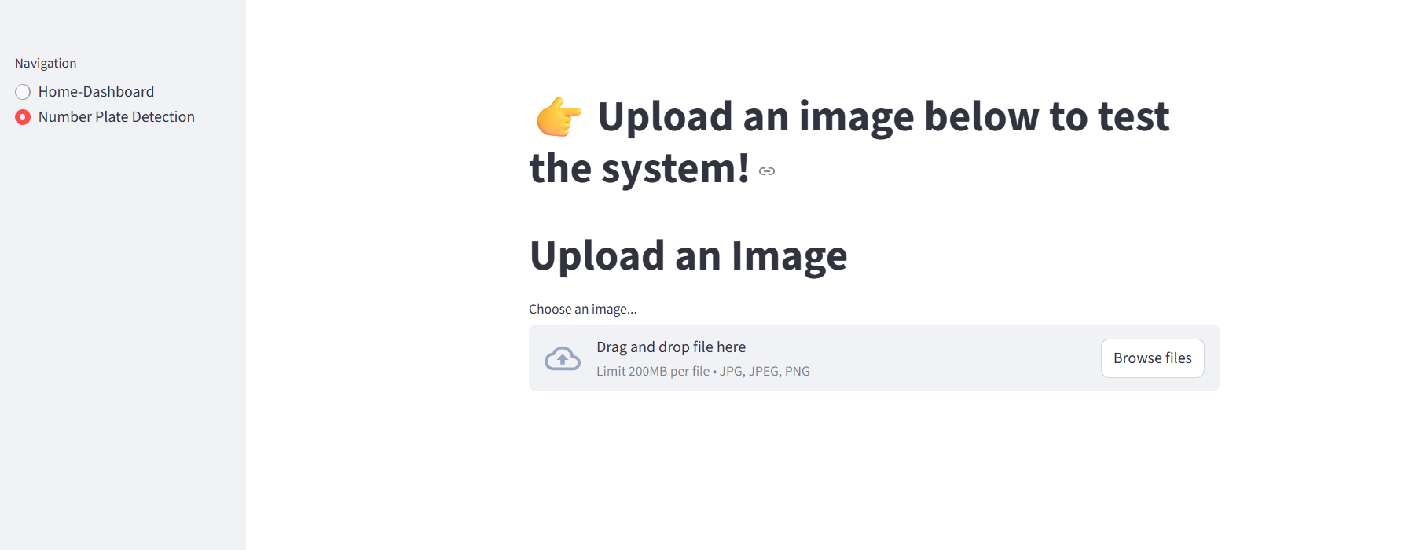
Develop a dashboard that enables user interaction to detect live images and identify number plates.

Slide 7
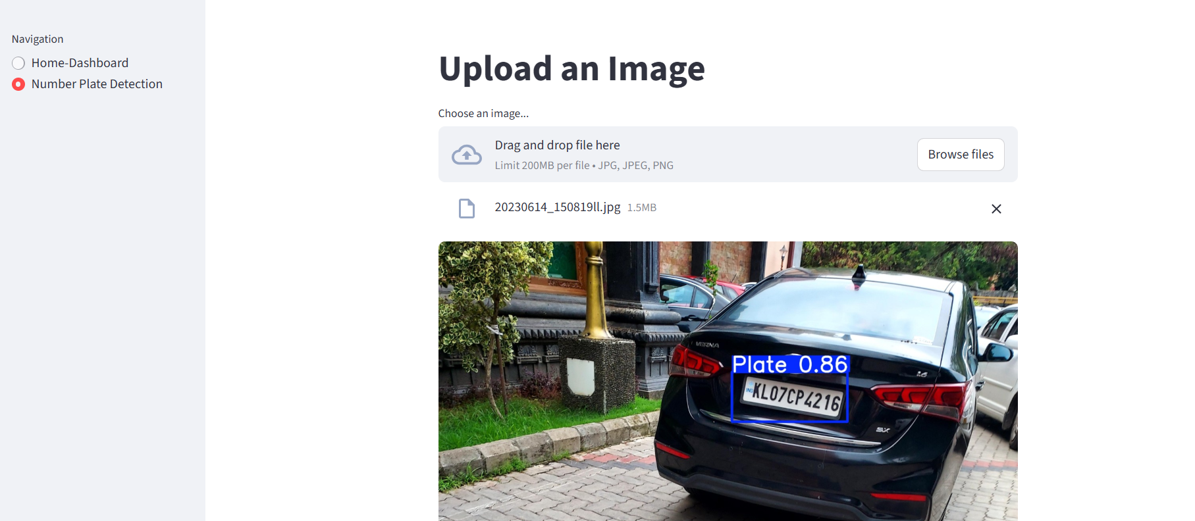
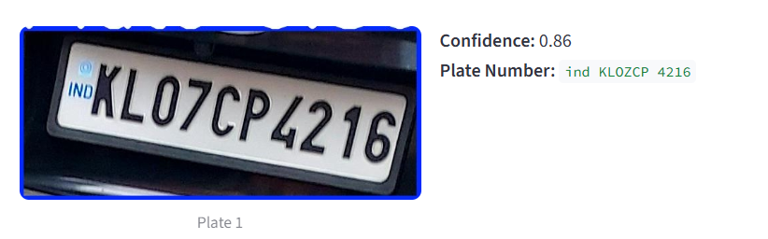
Upload a sample image where the number plate needs to be detected.
Once uploaded, our pre-trained model will process the image and identify the number plate.
The detected plate will be cropped, the value extracted, and the result displayed.

Slide 8
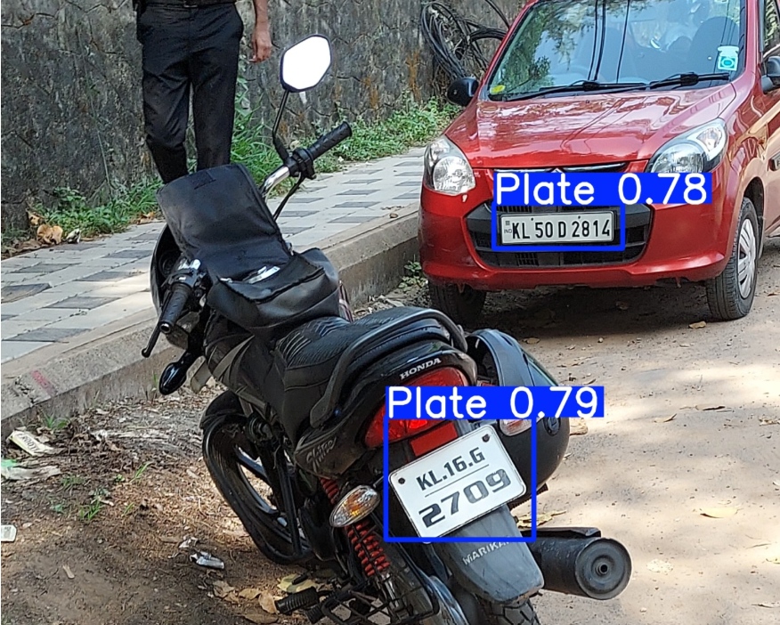
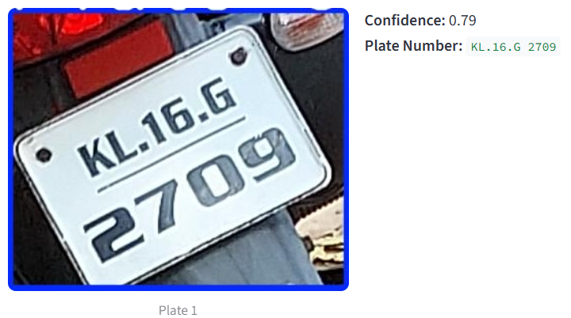
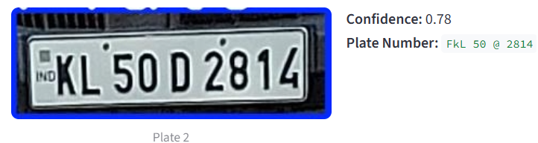
Upload a sample image where the number plate needs to be detected.
Once uploaded, our pre-trained model will process the image and identify the number plate.
The detected plate will be cropped, the value extracted, and the result displayed.

Slide 9
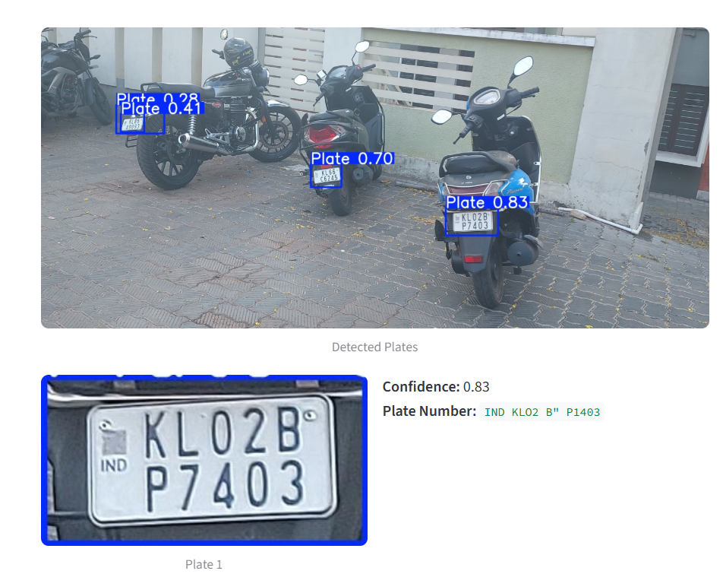
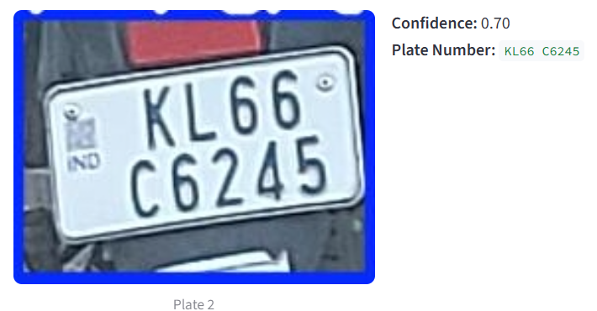
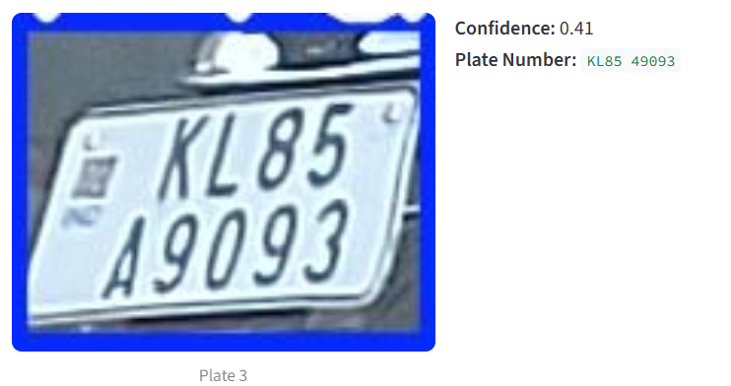
Upload a sample image where the number plate needs to be detected.
Once uploaded, our pre-trained model will process the image and identify the number plate.
The detected plate will be cropped, the value extracted, and the result displayed.

Slide 10
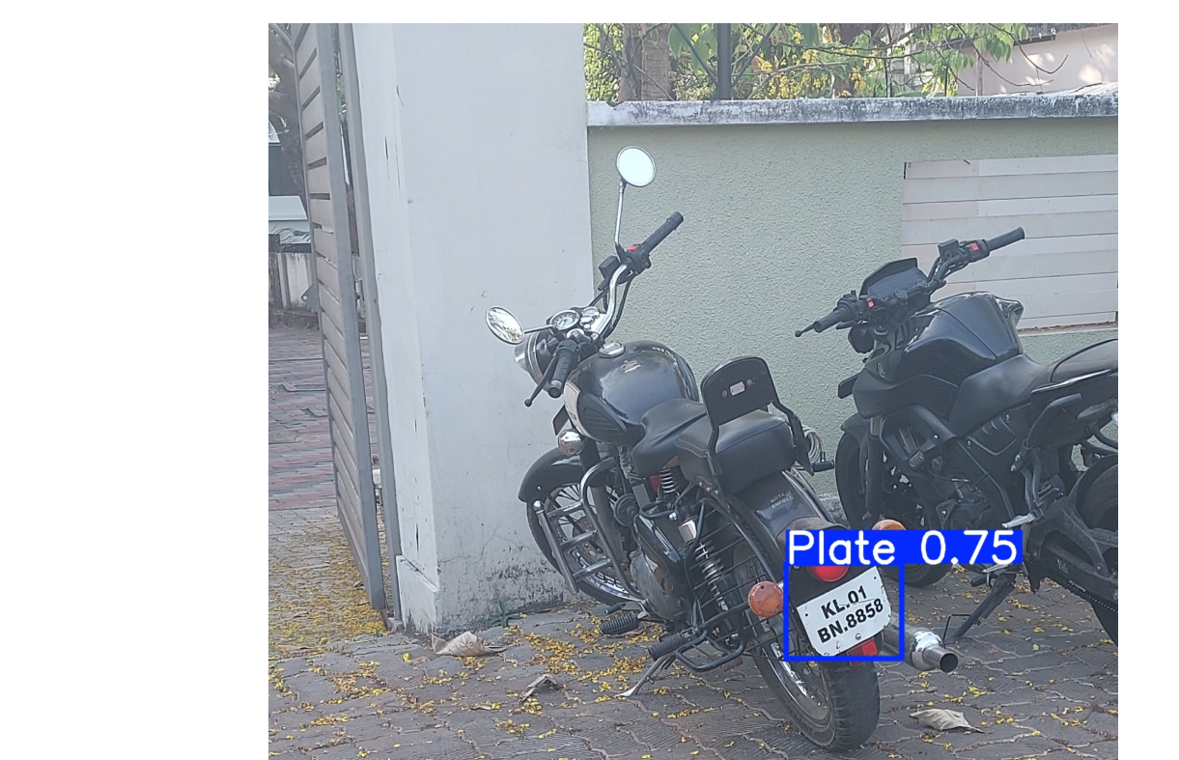
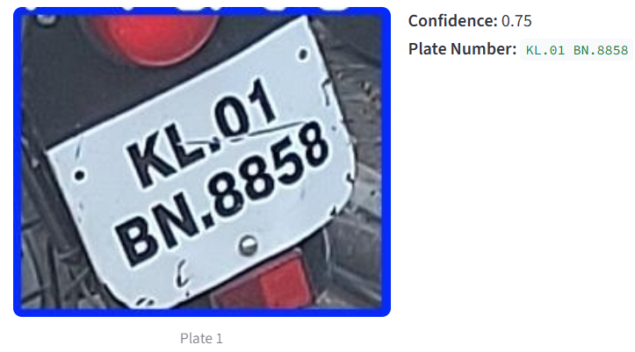
Upload a sample image where the number plate needs to be detected.
Once uploaded, our pre-trained model will process the image and identify the number plate.
The detected plate will be cropped, the value extracted, and the result displayed.

Slide 11
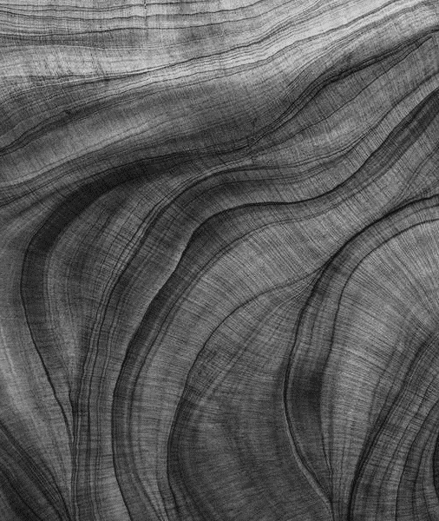
LLM Model

Slide 12
Model Objective
The primary objective of this project is to design and implement a Retrieval-Augmented Generation (RAG) system powered by the Llama 2 model.
In this system, users can upload PDFs or other documents and interact with it by asking questions. The model first retrieves the most relevant information from the uploaded content and then generates accurate, context-aware responses.
This approach enhances the model’s ability to provide precise answers that are directly grounded in the user’s data rather than relying solely on pre-trained knowledge.

Slide 13
Model Development
Download the LLM model and store it in the specified drive path to prepare it for training based on the requirements.
Load the dataset from the designated input folder as per the given requirement.
Apply a text splitter to divide the content into chunks of the defined size.
Generate embeddings using Hugging Face’s embedding models.
Store the processed document data in a vector database.
Load the model, design a prompt, and set up an answer retrieval pipeline to finalize the model.
Finally, input a question related to the uploaded document and retrieve the answer from the model’s response.

Slide 14
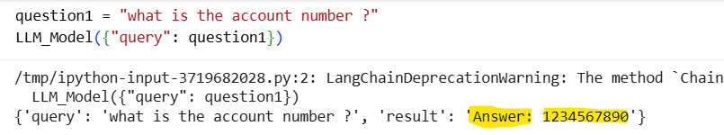
Sample Q&A’s

Slide 15
Thank you
Avinache. M
GUVI Team
Data Analyst

